Slide 1
Give me the damn Model for Threat Hunting
Kai Iyer

Slide 2
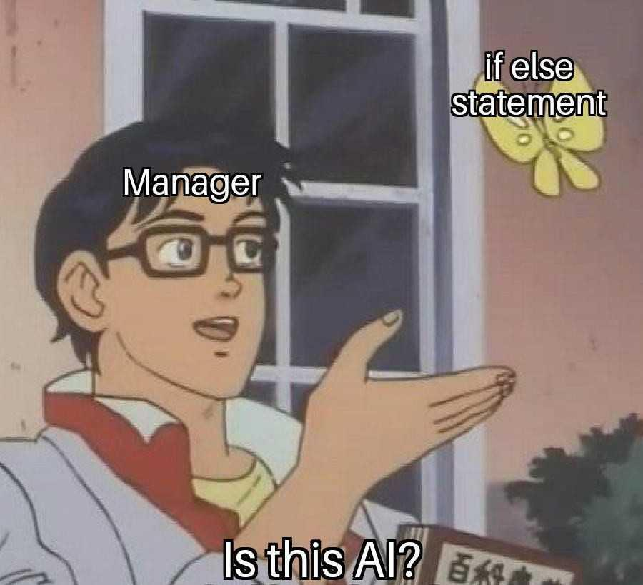
Agenda
whoami
Introduction
Limitations of traditional hunting
Diving into Jupyter
More Jupyter
A Lil More Jupyter
Takeaways
References

Slide 3
whoami /priv
Kai Iyer
Senior Security Consultant, EY Canada
Dev, Blog, Opensource, Privacy
Anime & Manga
find me @kaiiyer

Slide 4
Introduction
Threat hunting is an umbrella term for the techniques and tools organizations use to identify cyber threats
Traditional threat hunting was a manual investigation process relied on the expertise of Analyst, rather than automated tools, modern threat hunting depends on a combination of the two
Types:
Structured → Look for suspicious TTPs
Unstructured → Look for IoCs
Ad Hoc

Slide 5
Limitations of Traditional Hunting
Too much data Abundance of data hampers efficient threat analysis
Limited Scalability Challenging for analysts to manually identify relevant patterns and anomalies at large scale
Static Nature of Hunts Fixed rules or patterns are ineffective against dynamic and constantly evolving threats
Inability to Address Unknown Threats Unable to identifying threats not previously encountered

Slide 6
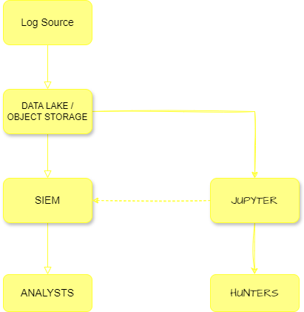
Data Flow
Log Source
DATA LAKE/ OBJECT STORAGE
SIEM
JUPYTER
ANALYSTS
HUNTERS

Slide 7
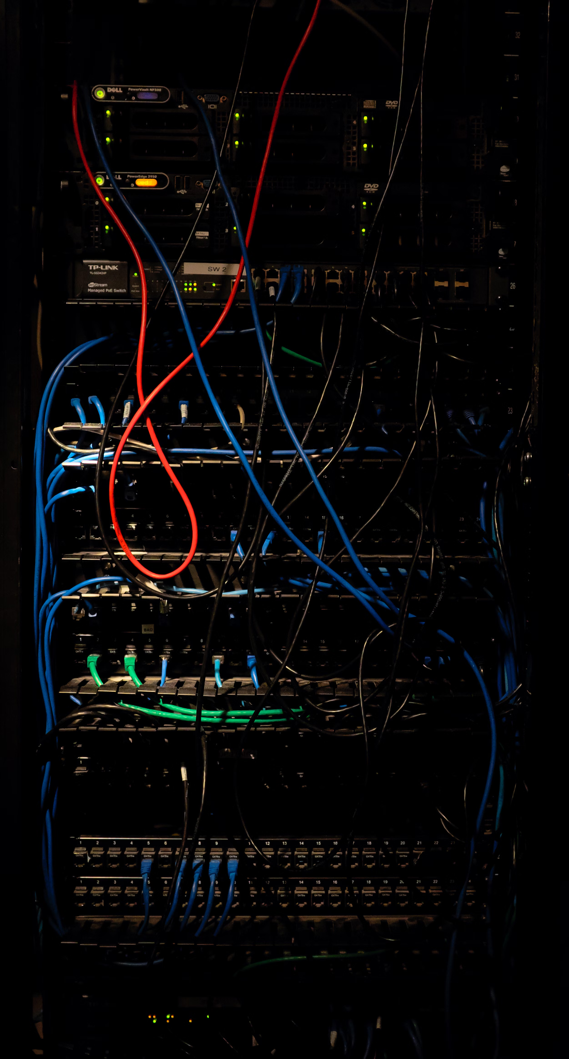
Terms to keep in mind
Activation Function
A simple math function that converts a given input into a desired output within a specific range
Optimizer
A method used to adjust the parameters of a neural network to minimize the loss function during training
Loss function
A method of evaluating how well your model's predictions match the actual data
Photo by Kenny Eliason on Unsplash
Notes:
Introducing non-linearity into a neuron's output

Slide 8

Terms to keep in mind
Bias It is the difference between the average prediction of our model and the correct value
Variance It measures how much the model's predictions change with different training data
Low Bias + Low Variance = Ideal scenario
Low Bias + High Variance = Overfitting
High Bias + Low Variance = Underfitting
High Bias + High Variance = Poor model
Photo by Magnus Östberg on Unsplash

Slide 9
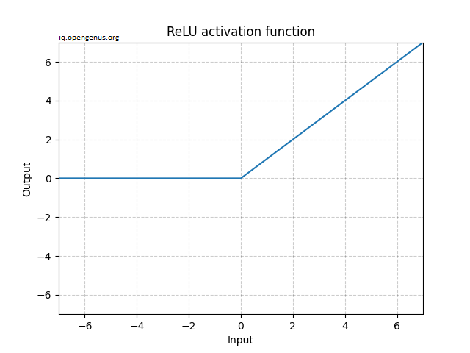
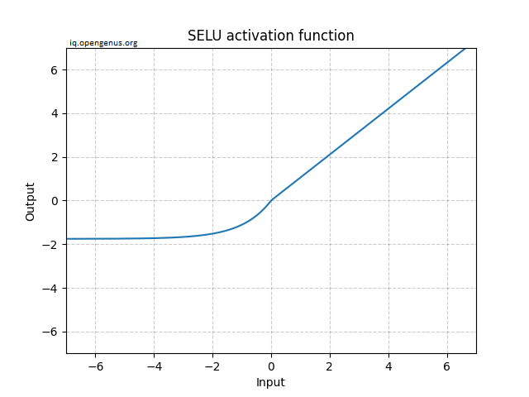
ReLU vs SELU

Slide 10
Enough Slides, show me the damn model!!!

Slide 11

Takeaways
Challenges with traditional Threat Hunting
Jupyter based Hunting Approach
Enhancing Hunting with ML
Automating Threat Hunting Methodology
Ease of Adoption and Integration

Slide 12
Questions?

Slide 13
References
https://iq.opengenus.org/scaled-exponential-linear-unit/
hhttps://neptune.ai/blog/vectorization-techniques-in-nlp-guide
https://course.fast.ai/
https://developers.google.com/machine-learning/crash-course/ml-intro
https://www.tensorflow.org/tutorials/generative/autoencoder

Slide 14
Thank You

